Slide 1
Android Programming Mobile Development
Dr Ian Drumm

Slide 2
Resources
Aims:
Including images and sound resources
Learning Outcomes:
Images
MediaPlayer
SoundPool

Slide 3
Review: Creating a new Android Application
The method setContentView() can associate the user interface with XML
public class Hello extends Activity {
@Override
public void onCreate(Bundle savedInstanceState) {
super.onCreate(savedInstanceState);
setContentView(R.layout.main);
}
}

Slide 4
Res/layout/main.xml
Specifies User Interface
<RelativeLayout xmlns:android="http://schemas.android.com/apk/res/android"
xmlns:tools="http://schemas.android.com/tools"
android:layout_width="match_parent"
android:layout_height="match_parent"
tools:context=".MainActivity" >
<TextView
android:id="@+id/textView1"
android:layout_width="wrap_content"
android:layout_height="wrap_content"
android:text="@string/hello_world" />
</RelativeLayout>

Slide 5
XML Widgets referenced as objects in Java Code
Using findViewById
TextView tv1;
tv1 = findViewById(R.id.textView1);
tv1.setText(“hello again”);

Slide 6
The OnClickListenerInterface
In the android api is defined this interface …
You can realise the interface with anonymous inner class
Hence handle button events
interface View.OnClickListener {
void onClick(View v);
}
myButton.setOnClickListener(new View.OnClickListener() {
public void onClick(View v) {
// your code to handle click event
}
});

Slide 7
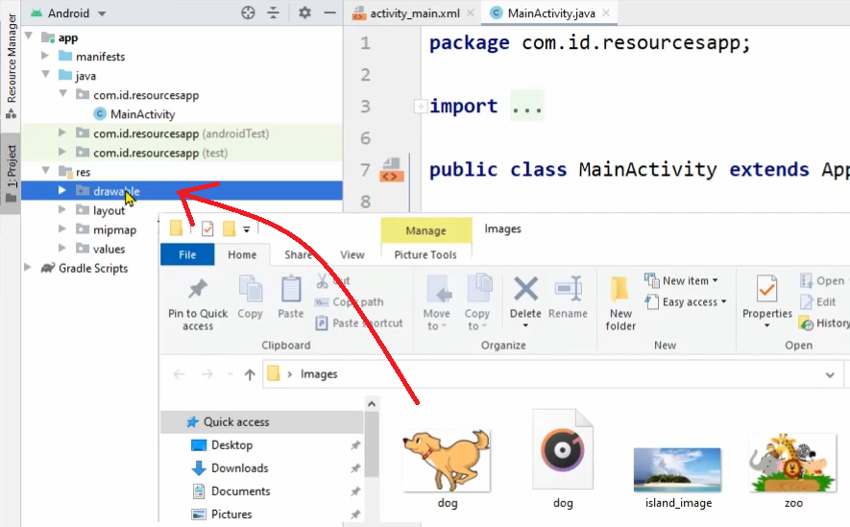
Adding Image Resources
Image resources can be created simply by dragging and dropping into res/drawable

Slide 8
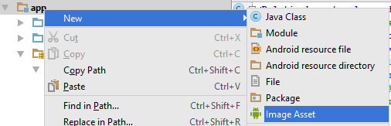
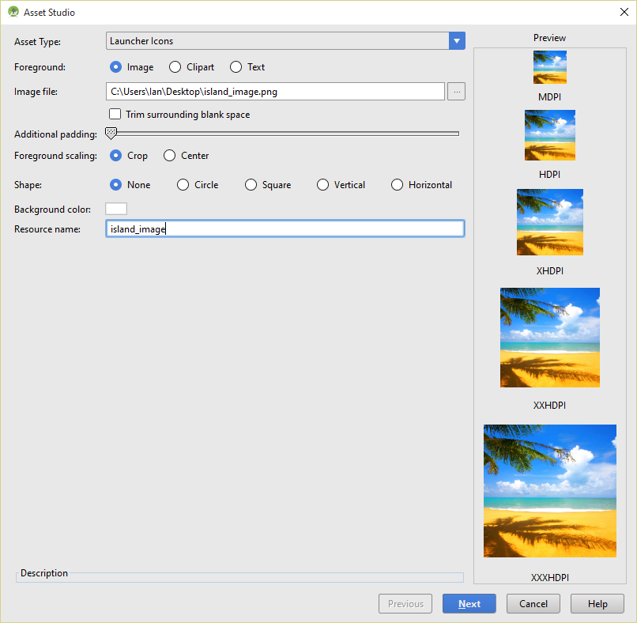
Adding Image Resources
Image resources can be created in project’s res/mipmap folder by adding new ‘Image Asset’

Slide 9
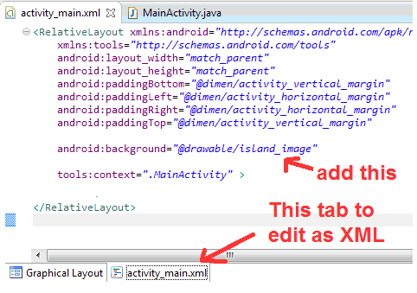
Setting image as background attribute
Leave off the ‘.png’ from attribute id

Slide 10
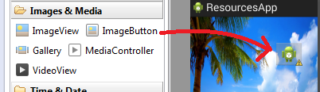
Using ImageButtons, ImageViews, etc
Add the image button to the graphical layout
Can edit XML in activity_main.xml
<ImageButton
android:id="@+id/imageButton1"
... some other xml ...
android:src="@drawable/cat“
/>

Slide 11
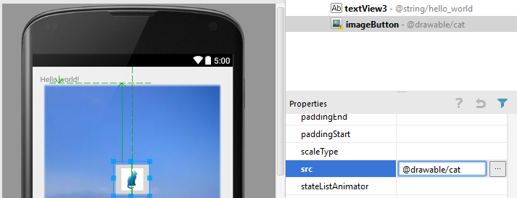
Properties window
Can set image button’s image via its properties window

Slide 12
ImageButton events
Define event handler
(anonymous class realises OnClickListener interface)
OnClickListener b1Handler = new OnClickListener() {
@Override
public void onClick(View arg0) {
// do something
}
};
Subscribe to button events
ImageButton b1;
b1= findViewById(R.id.imageButton1);
b1.setOnClickListener(b1Handler);

Slide 13
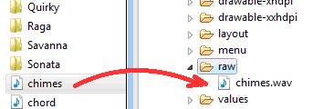
Adding Sound Resources
Wav files, etc added to sub directory of project’s res folder

Slide 14
Playing the sound with MediaPlayer
For long sounds like music
Declare a reference of type MediaPlayer
Use MediaPlayer’s create() method for object representation of sound resource
MediaPlayer mp1;
mp1=MediaPlayer.create(this, R.raw.chimes);
mp1.start();

Slide 15
Playing a sound with Sound Pool
SoundPool mySounds;
Declare reference
Set attributes
Load and play the sounds (soundID, leftVolume, rightVolume, priority, loop, rate)
audioAttributes = new AudioAttributes.Builder() .setContentType(AudioAttributes.CONTENT_TYPE_MUSIC) .setUsage(AudioAttributes.USAGE_GAME)
.build(); mySounds = new SoundPool.Builder() .setMaxStreams(2) .setAudioAttributes(audioAttributes) .build();
s1 = mySounds.load(this, R.raw.cat, 1); s2 = mySounds.load(this, R.raw.dog, 1);
mySounds.play (s1, 1.0f, 1.0f, 1, 0, 1); mySounds.play (s2, 1.0f, 1.0f, 1, 0, 1);

